Slide 1






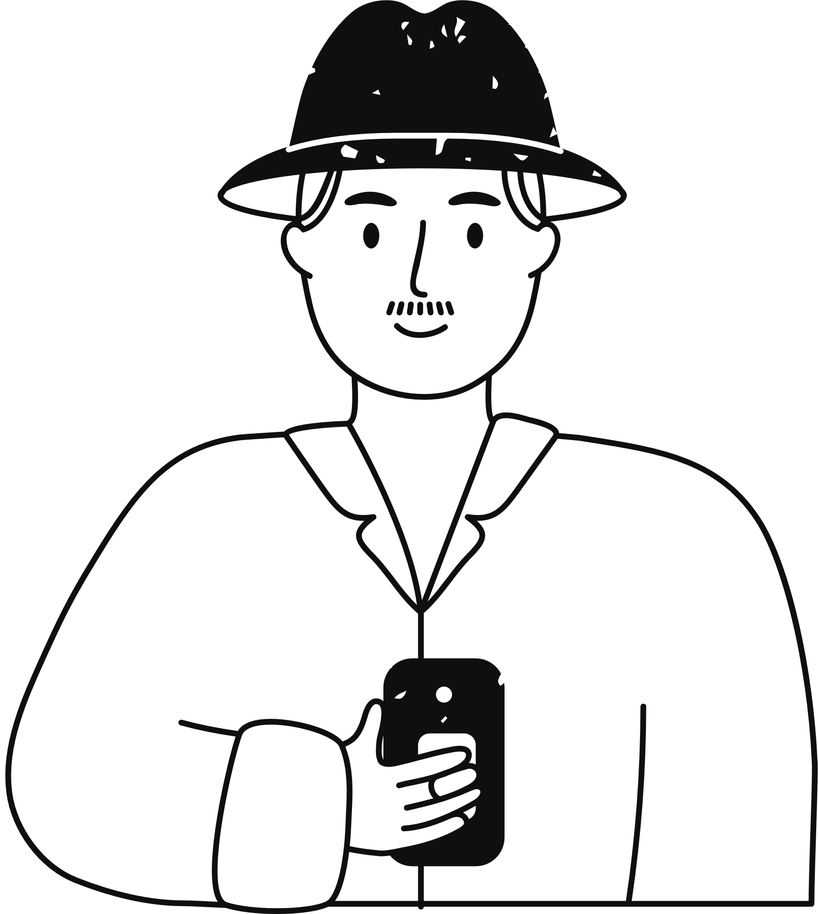


ExpressionLearner
(A speech recognition-based learning platform
for picture description designed for lower-grade students)
Presented by
Xuanhe Yang 2252709
Fubin Chen 2253715

Slide 2

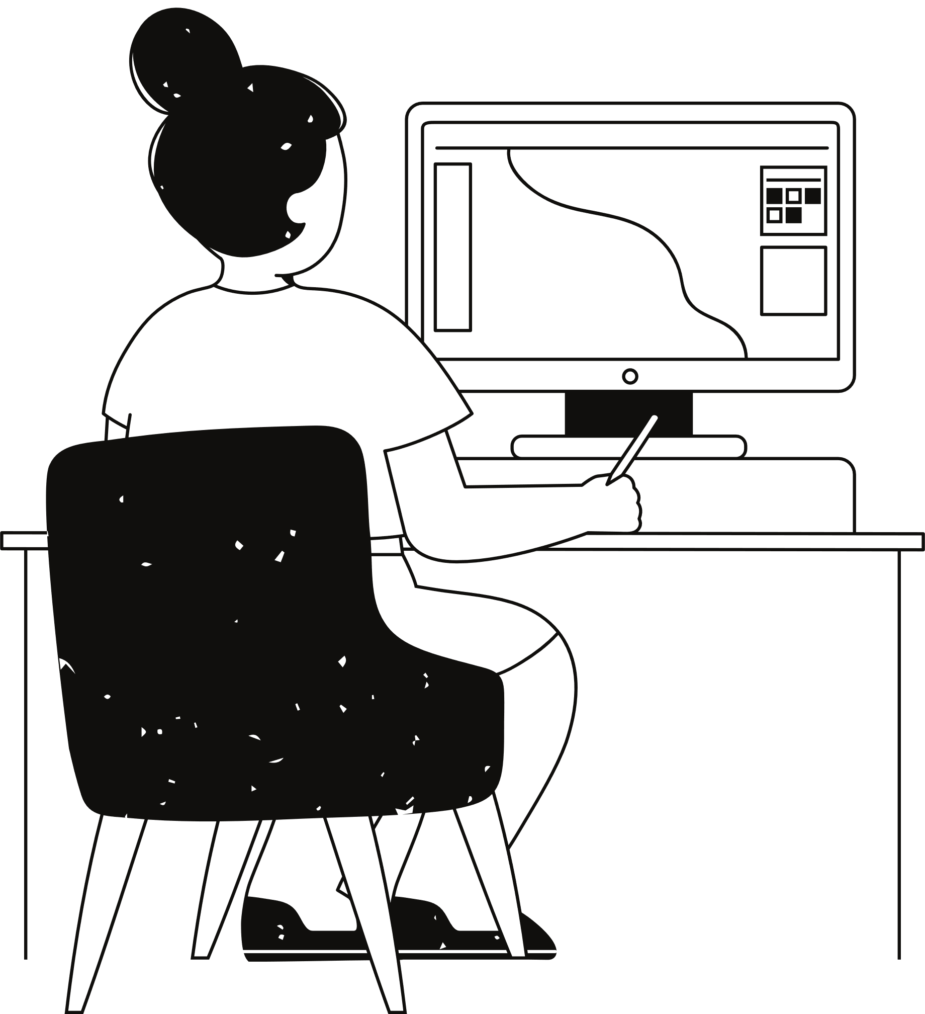
Part I&II
Problem
&
Survey

Slide 3
Background
Background
With the rapid development of technology, AI has transitioned from laboratory research to everyday life. Human-AI interaction has become a reality, from voice assistants like Siri and Alexa to intelligent customer service systems. This technological advancement not only enhances daily efficiency but also introduces new possibilities in the field of education.
Connection
Once we think of speech recognition, dialogue naturally comes to mind, as it’s a key way humans learn. This led our team to explore its application in education, focusing on enhancing learning through real-time feedback and guidance.So we did a survey on the speech recognition based products.

Slide 4

Survey&Problem
Speech Recognition-Based Product
Then, we researched existing products on the market and discovered speech recognition-based products in the field of education.
[Language Learning] [Reading and Pronunciation Training] [Voice-based Quiz Systems]
Duolingo

Slide 5



Survey&Problem
But, we found that Most products on the market are designed for individuals with a certain level of self-learning ability.It’s hard to child to use it to improve expressive abilities!
No friendly!!
Moreover, as we all know, due to environmental pressures, children in China are often forced to learn many advanced knowledge from a very young age.
Go study!
Yes, Mom...
However, hiring private tutors can be very costly, and many children do not enjoy this approach. Therefore, we aim to develop a language learning platform designed for children that combines education with entertainment.

Slide 6


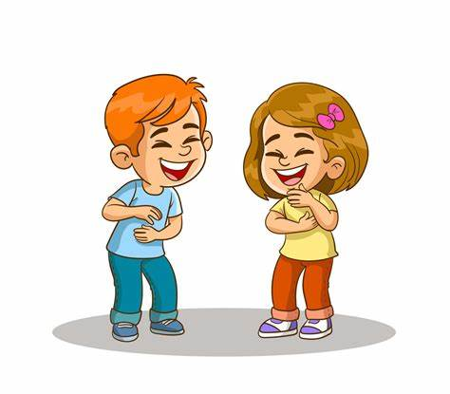
Our idea
ExpressionLearner is a web platform built on speech recognition, integrating various language analysis AI interfaces. It helps children create more imaginative sentences based on pictures, with guidance and corrections to improve their language skills.
Target : lower-grade elementary students
Purpose : Improve their expressive abilities
Why Pictuer-Based ?
Simply using speech recognition to generate text and interact with an AI teacher can be too monotonous. Considering that children enjoy visual learning, we chose to adopt an education method based on speech recognition combined with picture-based storytelling.
Kid -friendly Design :
I . Easy to use
II . Child-friendly GUI
III . Provided pictures and
AI generated responses to children’s preferences

Slide 7


Part III
Structure
&
functionality

Slide 8



Design Approach
Tech Stack :
Frontend
Backend
Database
AI We may used :
[Speech Recognition] [Large Language Model]

Slide 9
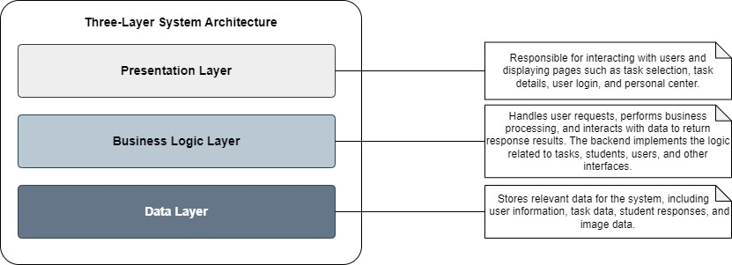
Architecture
Three-tier Architecture
Presentation Layer: Responsible for user interaction, displaying task selection, task details, user login, personal center, and other pages.
Business Logic Layer: Processes user requests, handles business logic and data interactions, returns response results. The backend implements interface logic related to tasks, students, and users
Data Layer: Stores system-related data, including user information, task data, student responses, and image data

Slide 10
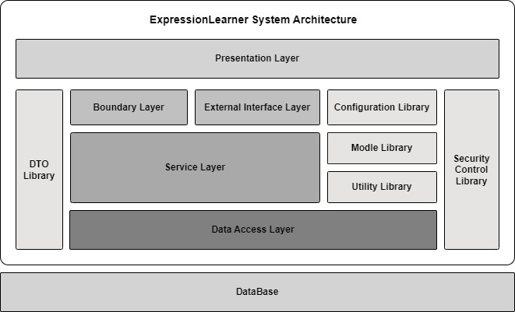
Architecture
Overall Architecture
Service Layer
core business logic layer, connecting presentation and data access layers
Data Access Layer
Handles database interactions
Boundary Layer
Manages interactions between external systems and internal components
External Interface Layer
Facilitates integration with third-party services or APIs
Utility & Configuration Libraries
Provides reusable tools and configurations for system operations
DTO & SC
supports efficient and clean data exchange
Ensures secure communication

Slide 11
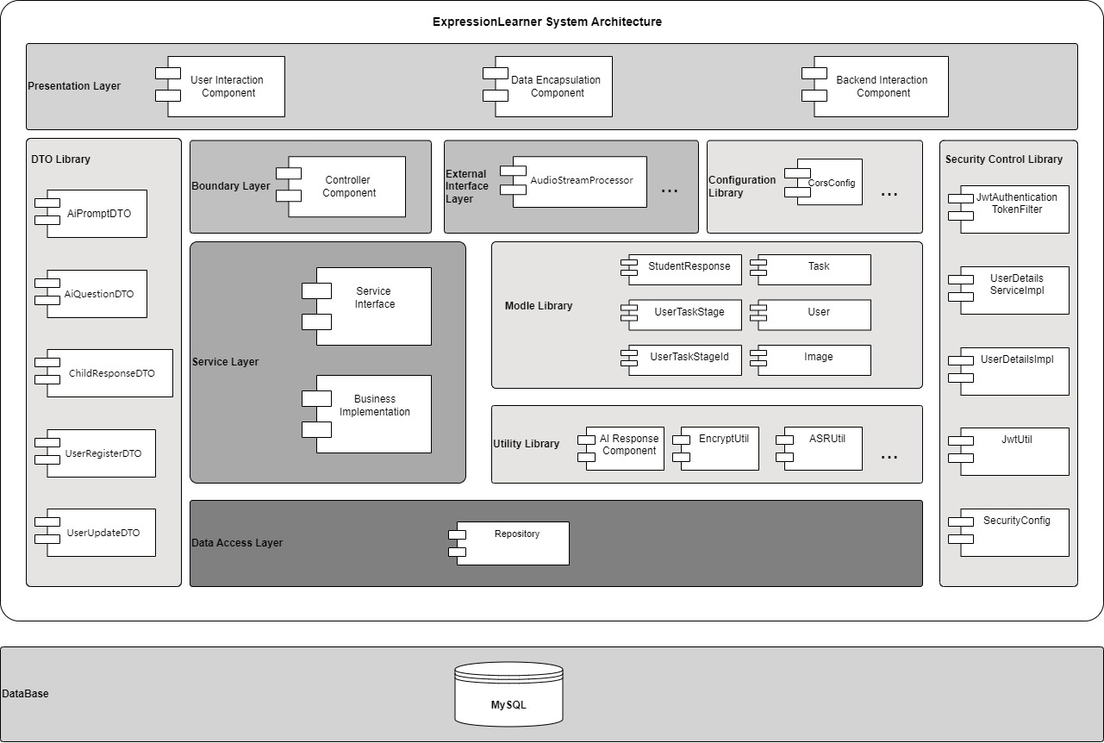
Architecture
Detailed Architecture
Next, we will provide introduction to the components and interfaces.

Slide 12
Functionalities
I . JWT Security Authentication
using Spring Security with stateless JWT tokens for secure and convenient login
II. User Registration and Login
llow users to create accounts with input validation and encrypted password storage.
Enables secure access using username/password authentication and JWT token generation
III . User Profile Center
Provides user information overview and update capabilities, including task history tracking
IV . AI Feedback and Prompting
Evaluates students' storytelling on completeness, logic, and emotion, providing real-time feedback and word suggestions to improve language skills
V . Real-time Speech Recognition
Converts voice to text using WebSocket for real-time narration, enhancing task interactivity and engagement.
VI . Task Functionality
[Narrate stories based on images] [Receive mode-specific AI feedback] [Track task history and progress]

Slide 13

Part IV
Performance evaluation

Slide 14
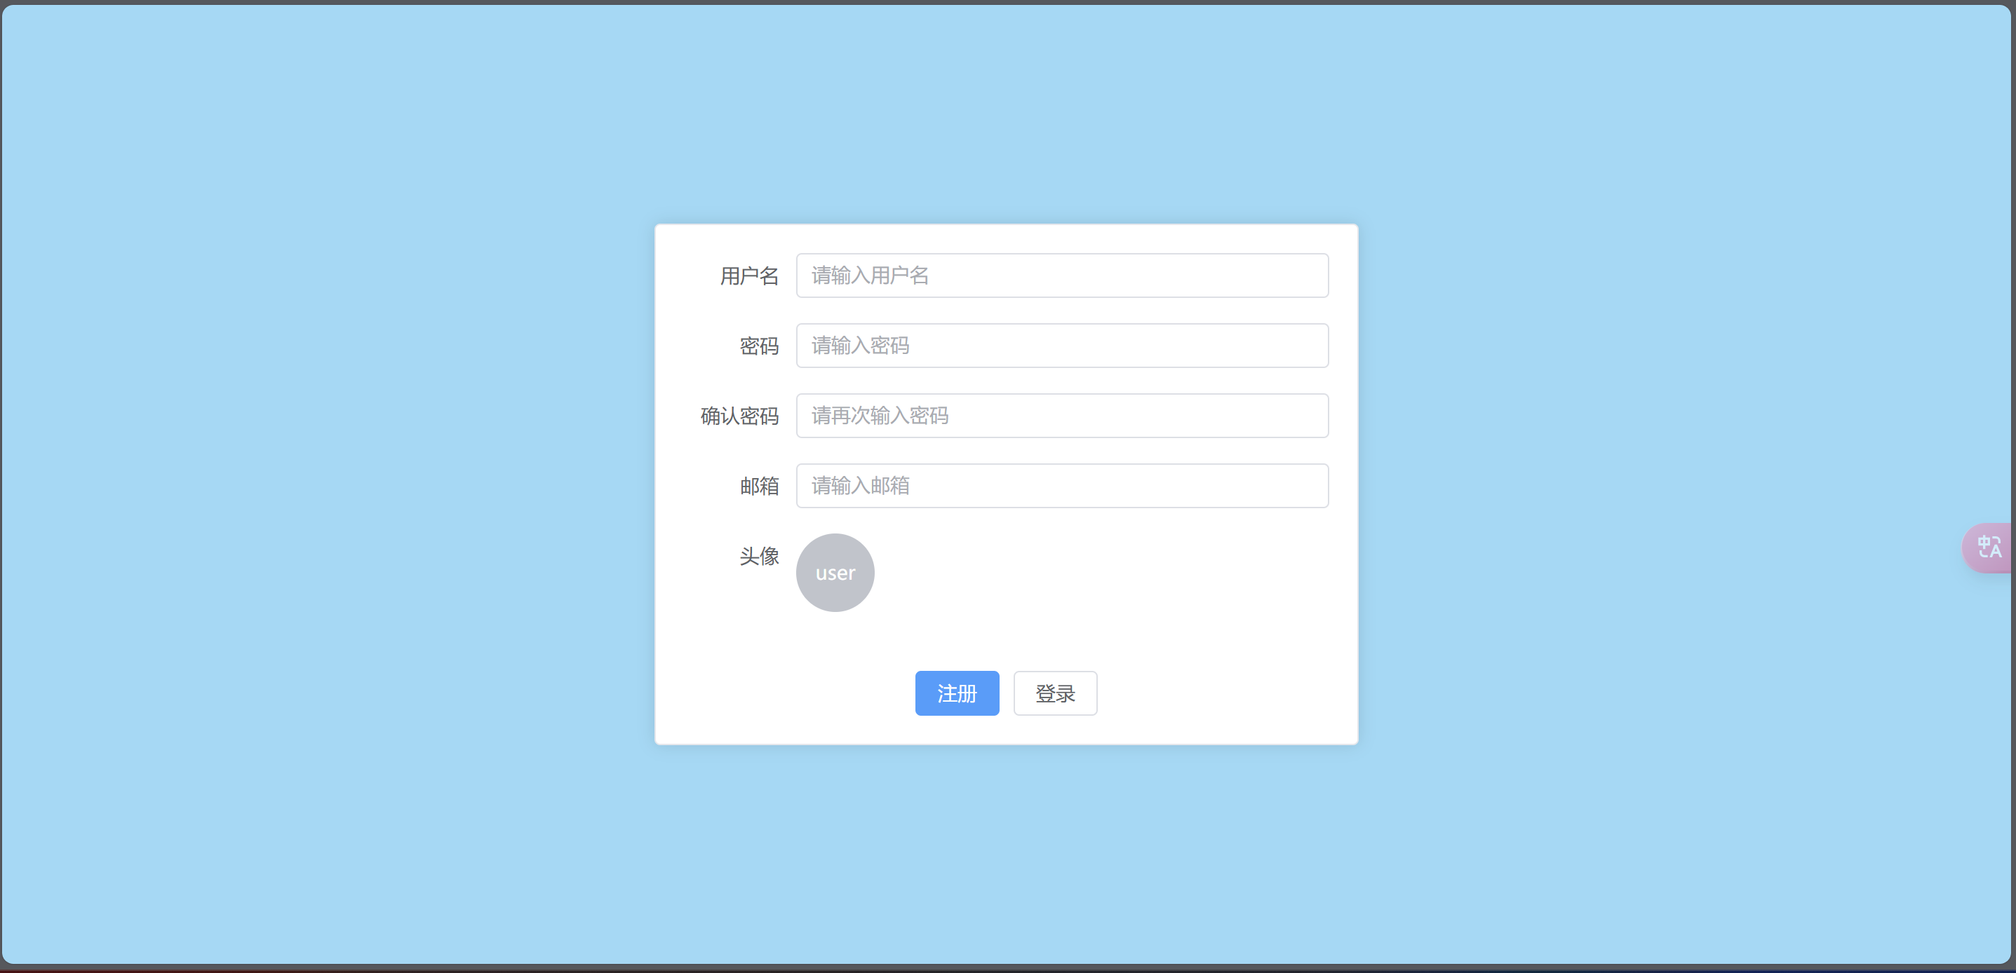

Features
Step-by-Step Registration&Login Process :
easily to get start!

Slide 15
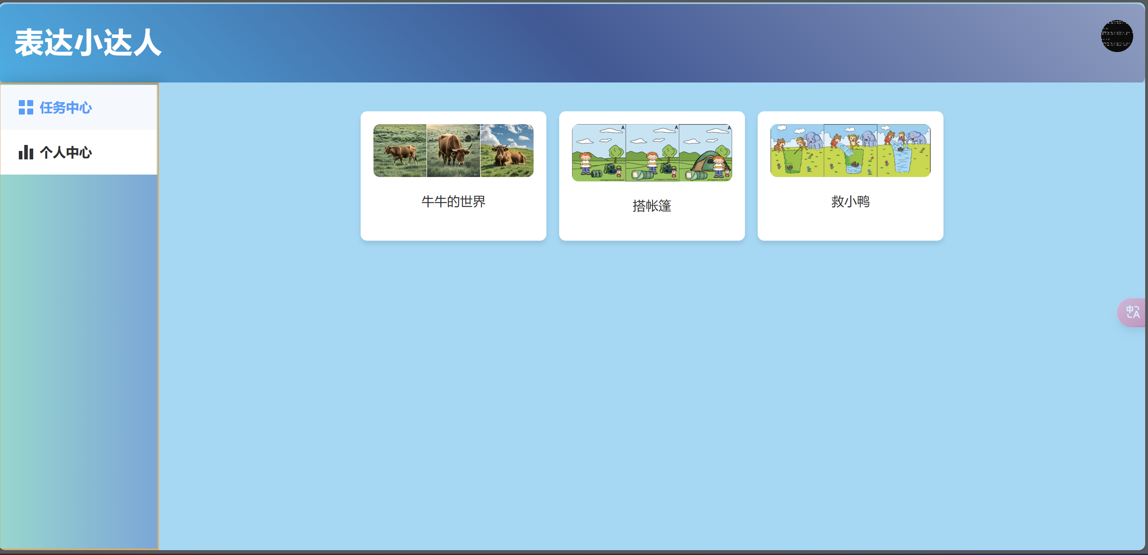
Features
Friendly GUI :
Simple and intuitive design for easy navigation and use

Slide 16
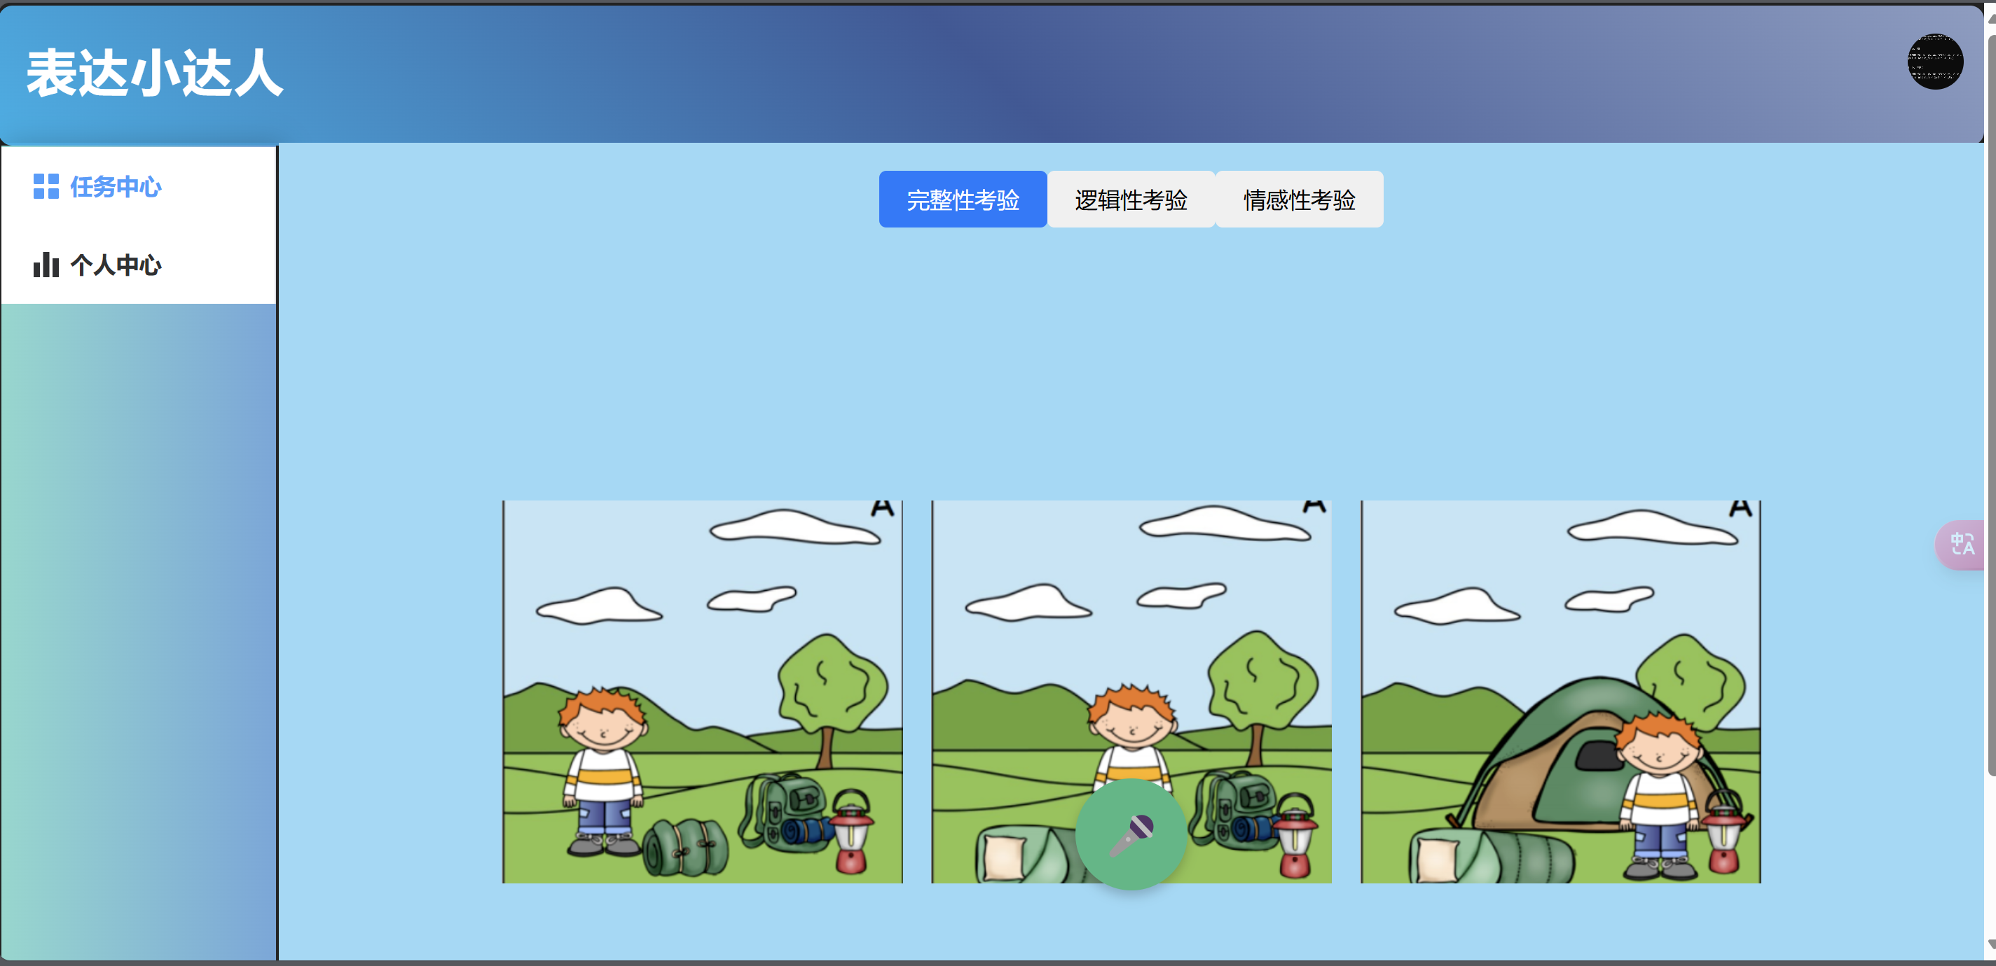
Features
Simple, Child-Oriented Picture Tasks :
Image-Based telling

Slide 17
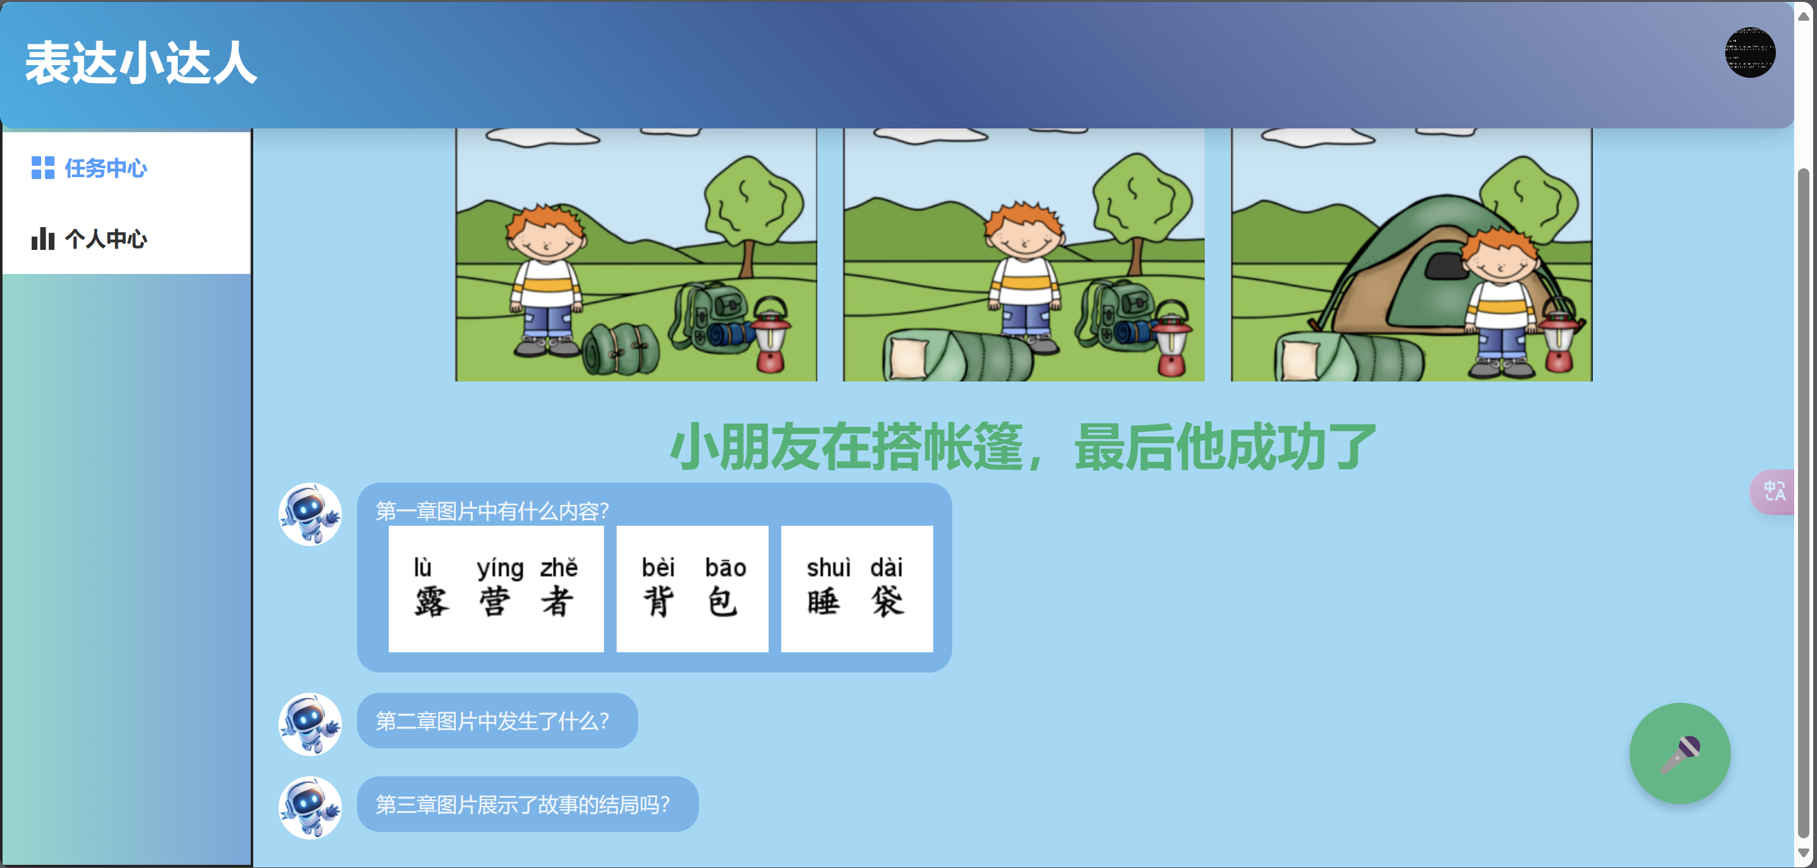
Features
Friendly AI Guiding :
Real-Time Speech-to-Text + Immediate AI Feedback

Slide 18

Features
Completed tasks history :
Task Review for Children

Slide 19

Demo
Watch
Our Demo!

Slide 20
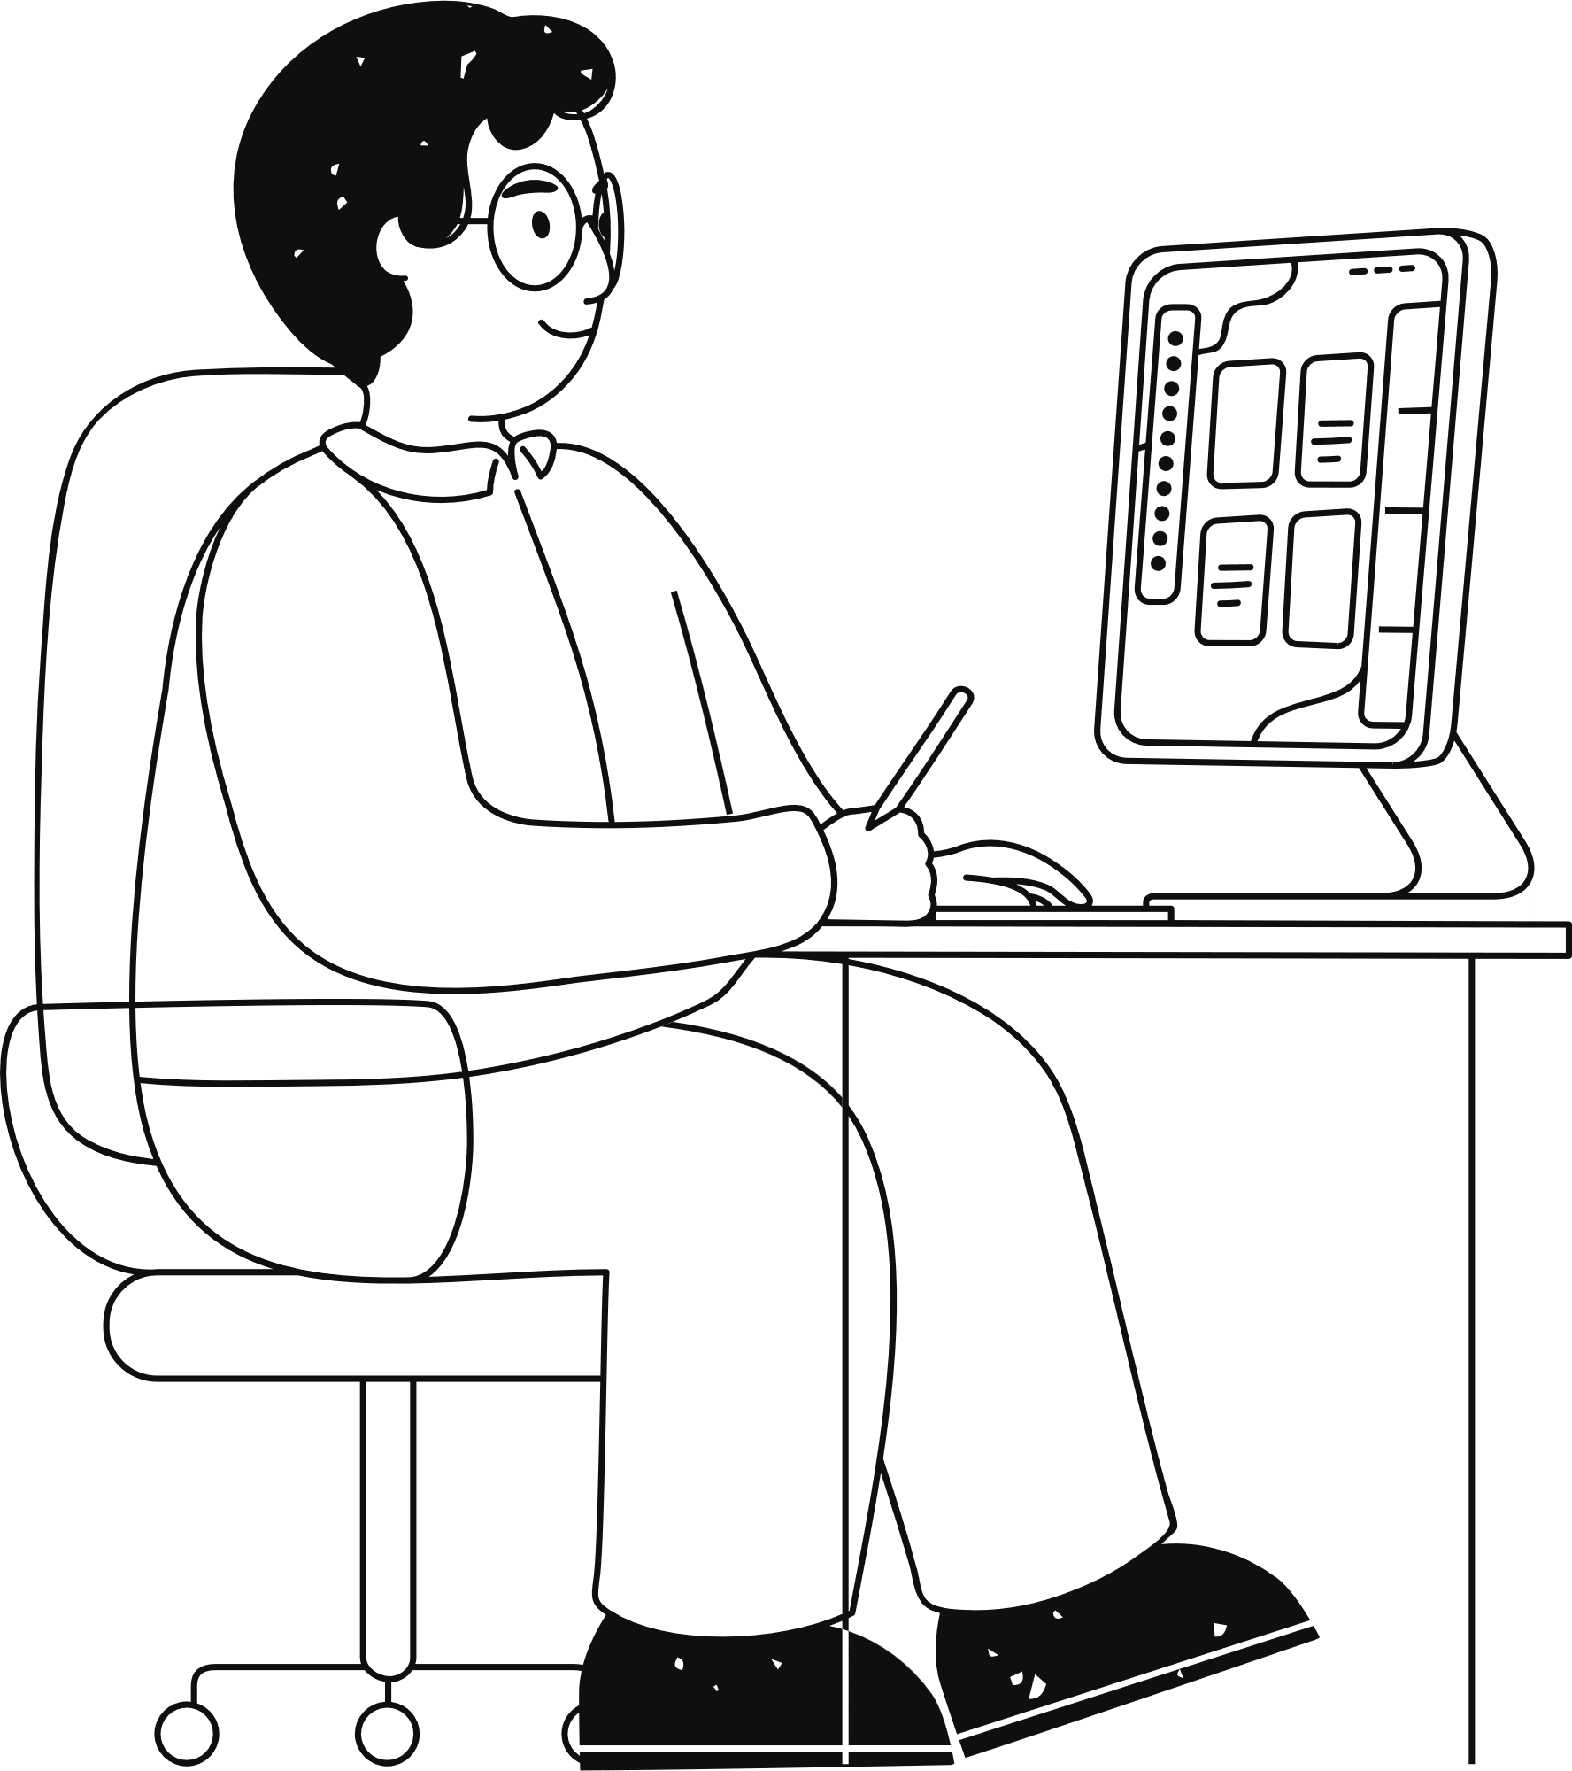
Part V
Advantages
&
disadvantages

Slide 21
Advantages
Speech-Recognition
I . Accuracy
We integrated the iFlytek speech recognition API, and during initial testing, the recognition accuracy was particularly low. Later, we discovered that by fixing the event interval and size of data sent to the iFlytek platform via WebSocket to certain values, the accuracy improved significantly.
II . Real-time capability
Our speech recognition results don’t appear only after the entire sentence is spoken. Instead, the system returns recognition results at regular intervals during speech. It also dynamically adjusts the output based on the context and, upon completion of the speech, provides the final version it deems most accurate.
Pictures-Based
I . Funny
We provided child-friendly images to encourage children to describe what they see, making the learning process more engaging and fun.
II. Inspiring creativity
Providing images allows children to freely express themselves, which better stimulates their imagination.

Slide 22
Advantages
AI Reply
I . Profession
We configured the language model with specific prompts to focus on analyzing language logic, sentiment, and its relevance to the provided image. This enables the AI to better guide children in enhancing their language expression skills.
II . Children-friendly
We tailored the AI to serve children by avoiding overly technical terms in its guidance. Additionally, we formatted its output as images with accompanying pinyin, making it easier for children to understand.

Slide 23
disadvantages
GUI
I . Child-unfriendly
Our GUI design lacks refined visual aesthetics, making the interface overly simplistic. That might make it challenging for some children to use the software effectively.At the same time, children may find the interface uninteresting and choose not to use it.
II . Lack of guidance
Our interface lacks proper tutorial guidance, and components like buttons only display text without pinyin assistance. Adding pinyin support and voice-guided tutorials could make the software more accessible for children.
AI reply
I . Lack of timeliness
Since we configured the AI responses to be processed into images with pinyin, there is a delay in the replies. This results in a less optimal user experience for children.
II. Only images and text
Due to time constraints, we only processed AI responses into simple text and pinyin images, without integrating speech synthesis to make it audible. This reduces interactivity and may affect children's understanding.

Slide 24






Thank you !

